Slide 1

Notes:
Input ‘agency story’

Slide 2

Our first responsibility is always you
Wealth Creation, Executive Sales & Furnished Rentals
Notes:
Input ‘agency story’

Slide 3

Tonight’s Event
What is Your Property Worth? Potts Point Property Growth
Property Sales comparison from 2010 to 2017
doTerra Essential Oils

Slide 4

Trisiana Muljono
Principal Agent
Community Minded
Trish has spent 17 years in property, investing her time in the business and the local, eastern suburbs and inner city communities. She has developed the intuition needed to follow the market and create great outcomes for clients
____________________________________
0404 893 883

Slide 5


Testimonial
Potts Point Property
We wanted to thank you Trish for the exceptional service and assistance you have given during the purchase of our property and the management of our tenants in the interim. It has been a pleasure collaborating with you, and we will be sure to contact you in the future if we are thinking of selling or renting out our property again. We’ll hopefully see you around Potts Point!
____________________________________
Jason Dibb, Property Owner

Slide 6

Simon Hohnen
Sales Executive
Creative Thinker
Adept at thinking on his feet and coming up with great solutions for clients. Simon truly loves real estate and working with people, bringing an honest and persistent approach to sales
____________________________________
0420 374 756

Slide 7

Testimonial
403/1 Marian Street, Redfern
Special Thanks to Simon Hohnen for his time and effort on the sale.
In a very difficult market, it took a lot of patience and persistence on his part, I very much appreciate all that you have done for me. You were always there and followed up on every detail and any queries
I had during the process you were always helpful, professional and handled the situation with a smile. I would have no hesitation in recommending you to anyone considering selling their biggest asset.
____________________________________
Vendor

Slide 8

Tonight’s Presenters
Trisiana Muljono
Attila Motyan
Principal Agent, SydneyLinks
from doTerra Essential Oils

Slide 9

Trisiana Muljono
Principal Agent
Fund Trish has spent 17 years in property, investing her time in the business and the local, eastern suburbs and inner city communities. She has developed the intuition needed to follow the market and create great outcomes for clients
SydneyLinks Real Estate is a specialist innovative real estate for leasing and selling furnished and boutique properties. Since 1999, SydneyLinks Real Estate has succeeded the expectation of owners in gaining the best rental returns & managing their investment properties and, thus we have expanded our service in sales to our niche clientele.
www.sydneylinks.com.au

Slide 10



Attila Motyan
from doTerra Essential Oils
dōTERRA essential oils produces and distributes exceptionally high quality CPTG Certified Pure Therapeutic Grade essential oils all over the world. Attila Motyan, along with Anita Demeny, started Empower Naturally, which distributes these chemical free oils right here from Sydney

Slide 11
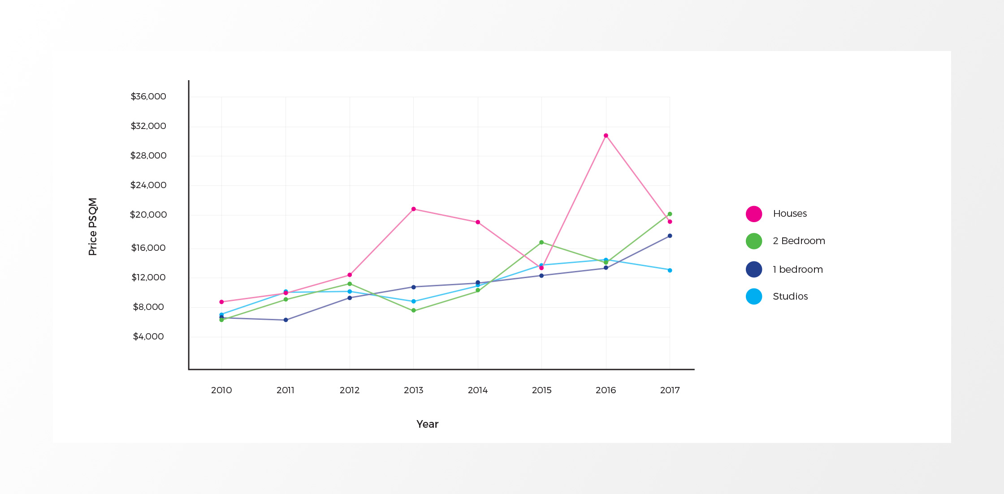
Sales
Comparison
Average price Per Square Metre
(PSQM) of property types from
2010 to 2017

Slide 12
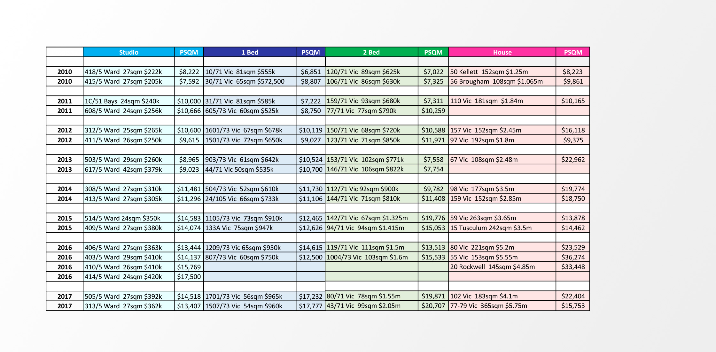
Sales
Comparison
Average price Per Square Metre
(PSQM) of property types from
2010 to 2017

Slide 13
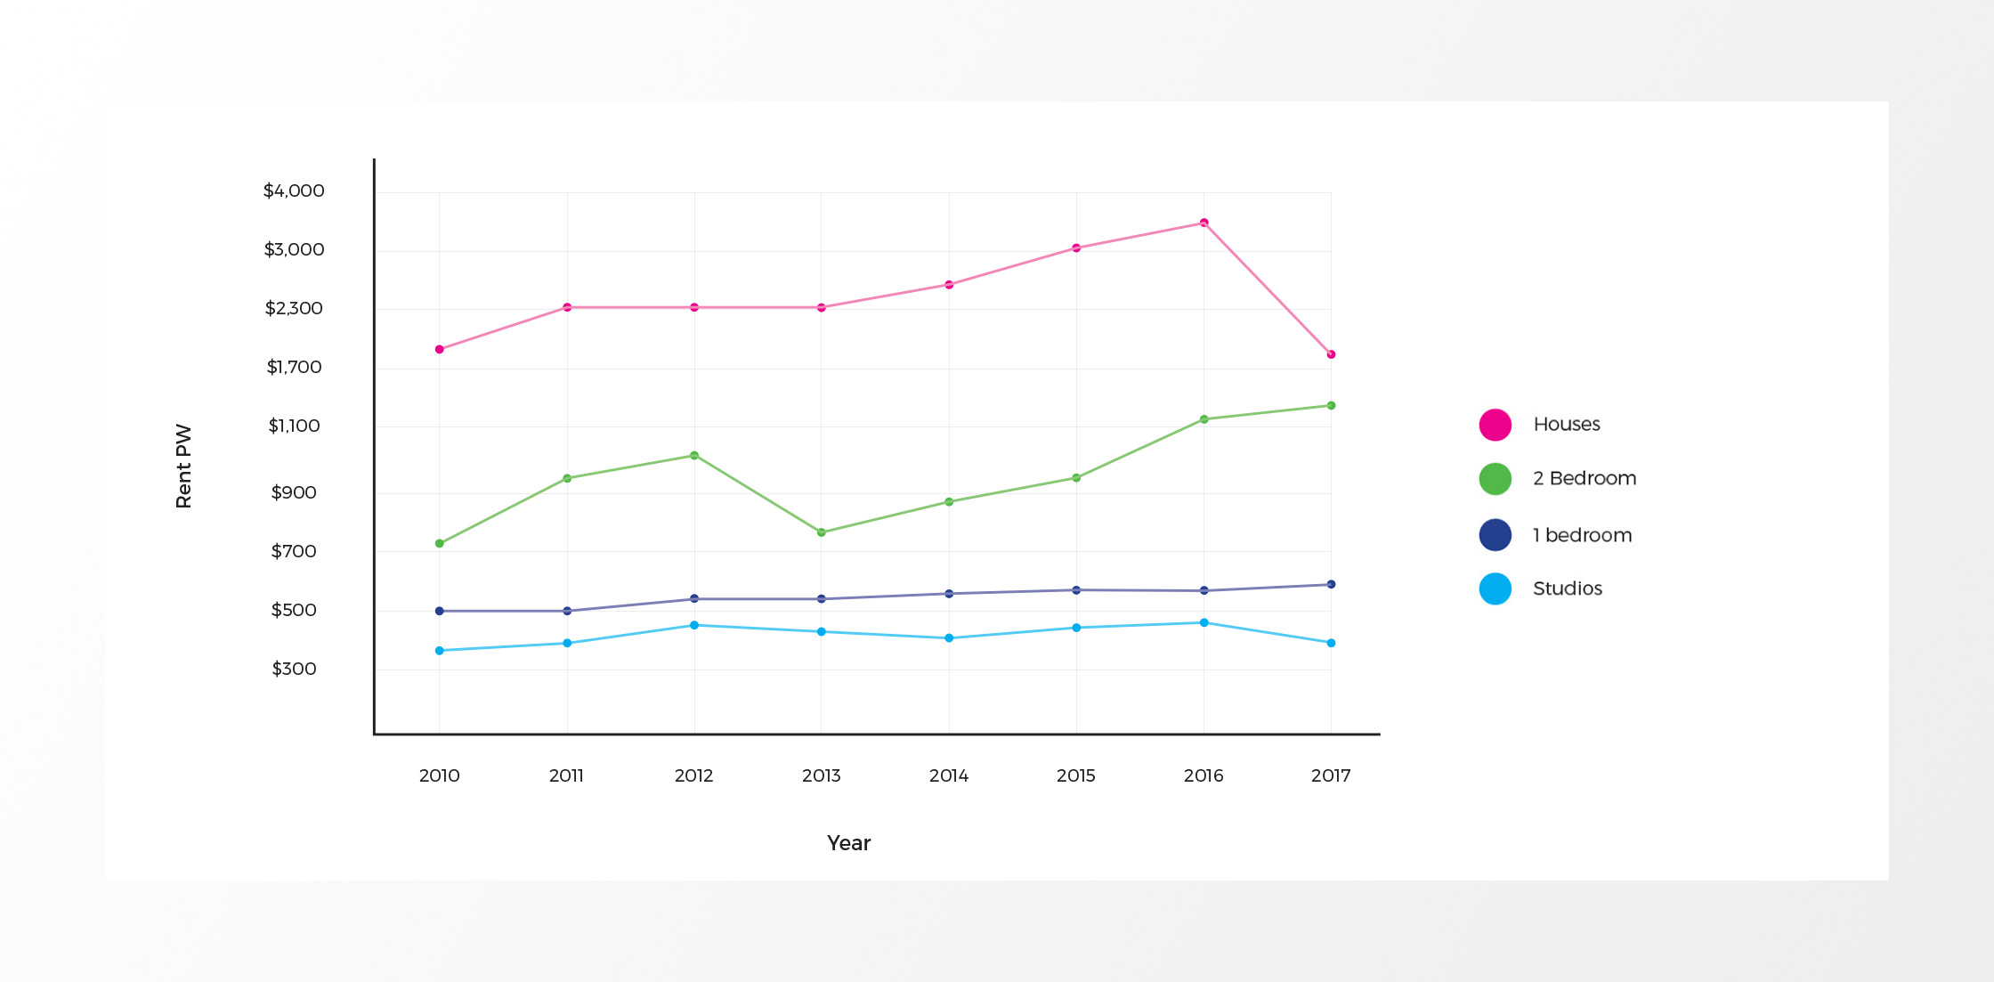
Rentals
Comparison
Average cost of rent per week of property types from 2010 to 2017

Slide 14
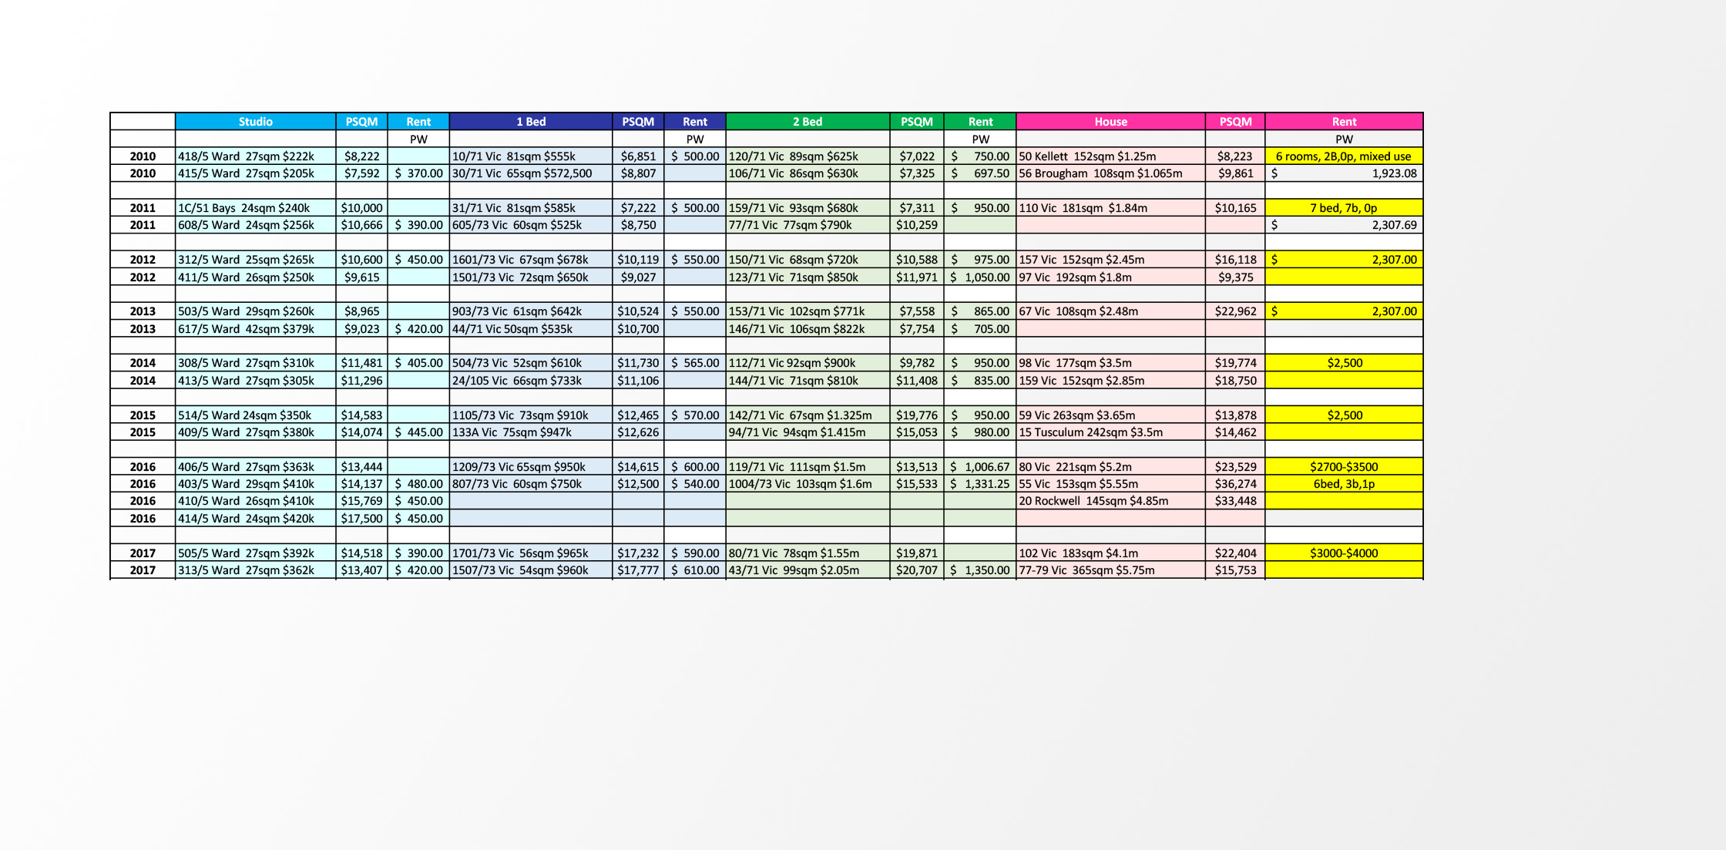
Rentals
Comparison
Average cost of rent per week of property types from 2010 to 2017

